Slide 1
FMC data – How to create a common file format
Tom Bertenshaw
BINDT FMC User Group Chair
21/02/2020

Slide 2
What are the issues around file formats?
File Formats should be chosen to ensure sharing, long-term access and preservation of your data. Choose open standards and formats that are easy to reuse.
Best practice for file format selection include:
non-proprietary
unencrypted
uncompressed
open, documented standard
commonly used by your research community
use common character encodings – ASCII, Unicode, UTF-8
Original raw data should be unedited and retained in its native formats
Document the tools, instruments, or software used in its creation.

Slide 3
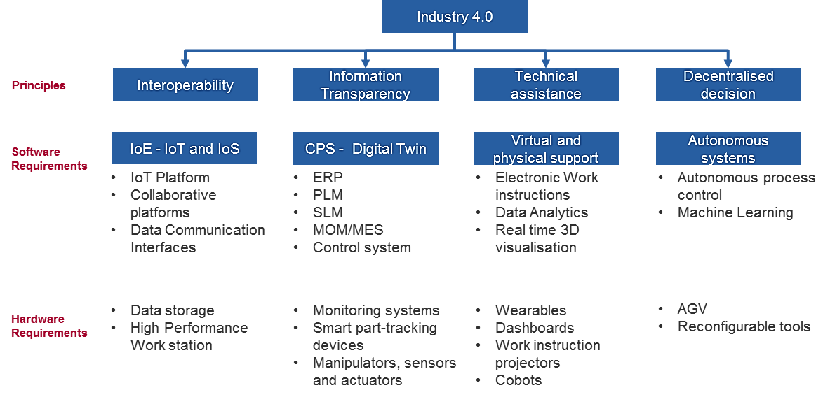
Why create a common file format?
Allows sharing of data and compatibility between file formats
This is a key enabler for Industry 4.0 initiatives, which can include:
Assisted Defect Recognition
Integrating data into factory systems for data feedback
Compatibility between in-service inspection data and factory inspection data

Slide 4
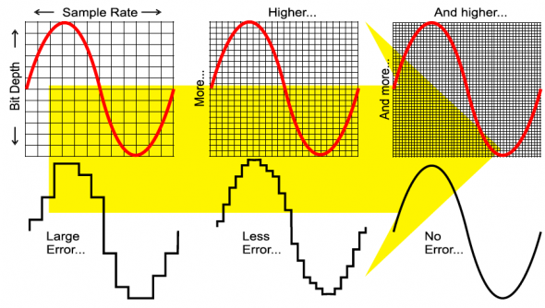
Key parameters when saving Ultrasonic data
Sample rate - The number of samples taken per second
The bit depth - This determines the amount of data that can be captured for each sample, for example:
8 bit - 256 values
16 bit - 65536 values
32 bit - 4,294,967,296 values
When saving data, we can use common data types to describe this information

Slide 5
Common data types
These data types can either be signed or unsigned. For example:
 | range
Signed short int | From −32,767 to +32,767 range
Unsigned short int | From 0 to 65,535 range

Slide 6
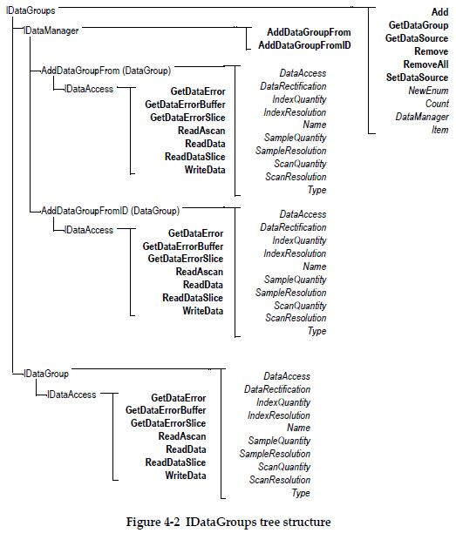
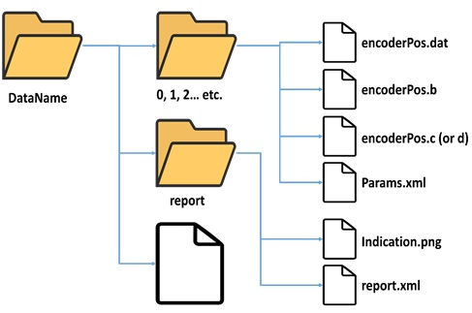
Data Structures
Here are two examples of data structures from UT software:
1st data structure example is used for FMC & TFM data and reporting information – it has a very flat structure in this respect
The 2nd data structure example is much more explicit in is structure,
It is also structured differently, meta data is stored at a different level outside this structure
Considering the differences in data structure, we have to also consider the difference in data types that may be used too
Data structure example 1
Data structure example 2

Slide 7
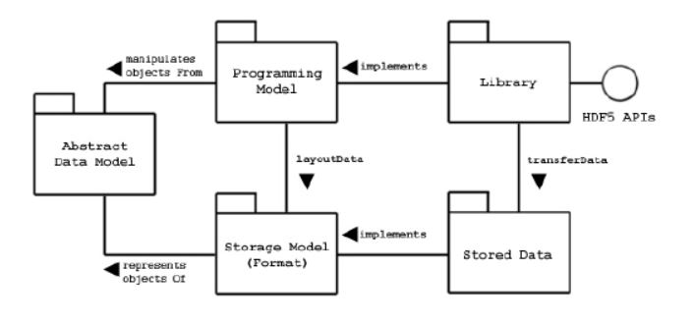
The HDF5 file format
The Hierarchical Data Format (HDF5) file format has been chosen to create a common file format for Full Matrix Capture Data
It was shown that a new FMC common file format based upon HDF5, offered the best balance between functionality, ease of adoption and development time.
HDF5 has its own API, complete with a library, and an abstract data storage model (below left)
User Software
Open source HDF5 Viewer
UoB MFMC common File Format library
HDF5 API
Read / Write library, compression Library
Low level HDF5 Functions
HDF5 File
Groups Datasets
HDF5 models and implementations
Routes to Read / Write MFMC Common Files Using the HDF5 API

Slide 8
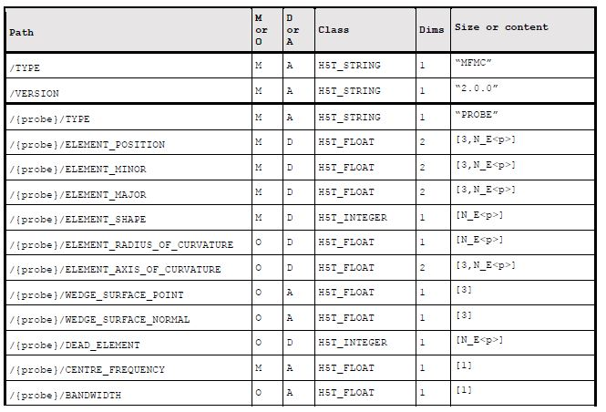
Proposed Common File Format (CFF) structure
Bristol University have developed a specification for a “Multi-frame Full Matrix Capture” (MFMC) Common File Format based on the HDF5 file format
THE HDF5 file format allows the user to define a hierarchical data structure
Bristol University have defined a data structure for MFMC CFF data

Slide 9
Where are we today?
TWI have funded a small internal project to write some code to read/write from their FMC/TFM software to the MFMC file format.
The seem to have achieved this
They identified several parameters they would like to see, such as wedge parameters, VSA/PWI parameters – this is broadly reflected by the weld inspections the do
These additional parameters are under consideration
Strathclyde have done some initial work on the creating code to write from their FSTRM software to the MFMC file format
Have partially done the coding – completed code for UT data probe location and any associated meta data
Need to complete MFMC sequence groups and law groups
Have been scripting in Matlab so far – long term plan to implement in C or C++ with Python and Labview bindings
There has been some talk about Strathclyde sending TWI some data via the Common File Format, once Strathclyde has completed their study

Slide 10
BINDT FMC User Group Objectives
The objectives for the future include:
Increase the adoption of the CCF with Equipment manufacturers
Encourage more instances of data sharing
Create a MFMC file checker
Revise and agree amendments to MFMC CFF where necessary
Future possible objectives:
Expand file structure to include PWI or VSA data
Standardisation if adoption becomes more accepted
Common file format for Full Waveform data?
Consider storing reconstructed data (TFM)

Slide 11
Credits and info
The HDF5 File structure Version 2.0.0 – Specification Document was written by Paul Wilcox at Bristol University
p.wilcox@bristol.ac.uk
Credits for file conversions to MFMC to date:
Romain Michalec - Strathclyde University
Robert Sampson – TWI Ltd
More information about the FMC user group can be found on the BINDT Website (needs updating!):
https://www.bindt.org/branches-and-committees/User-Groups/full-matrix-capture-fmc-user-group/

